Slide 1
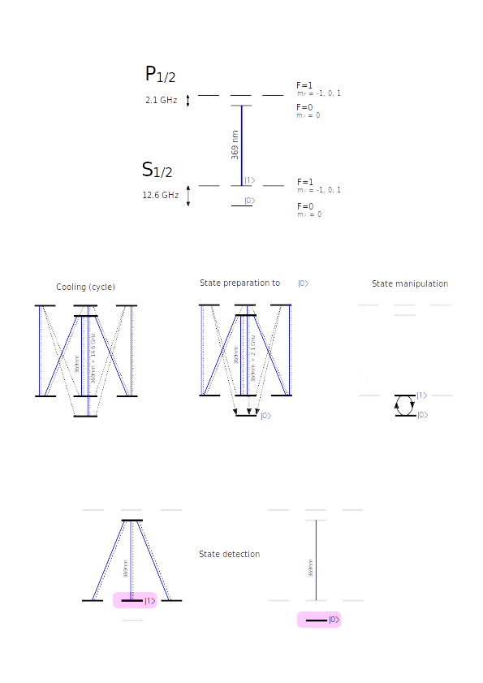
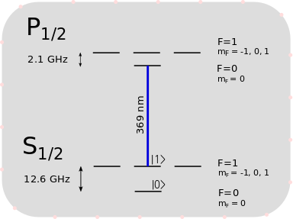
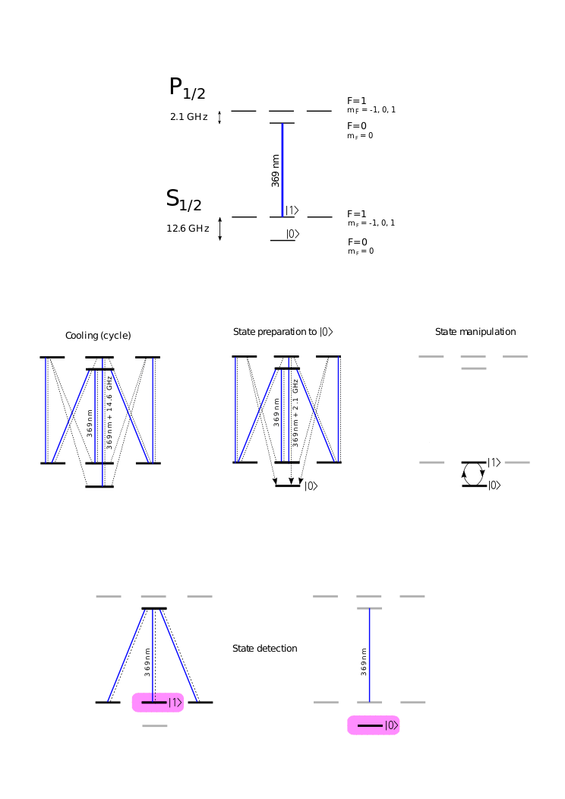
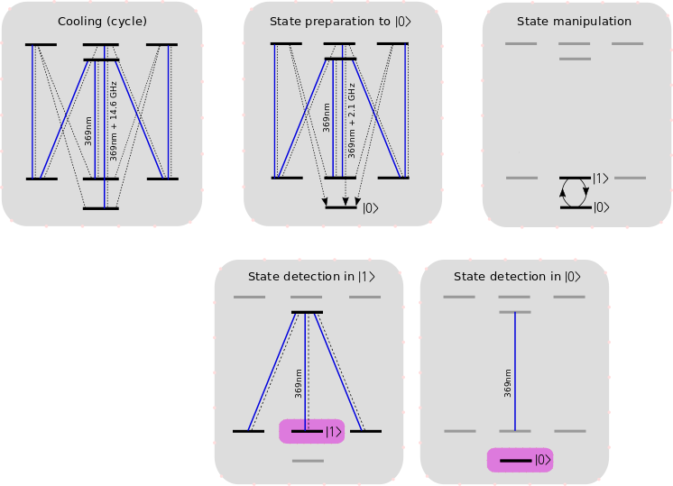
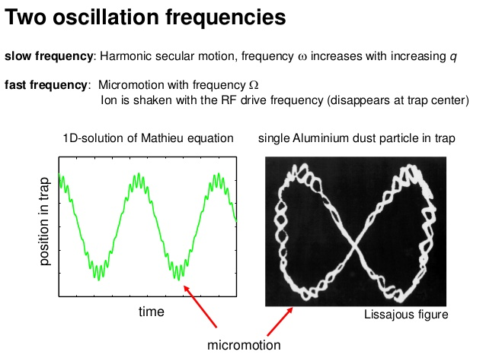
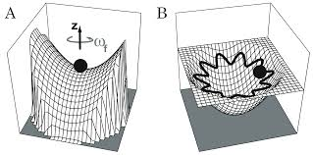
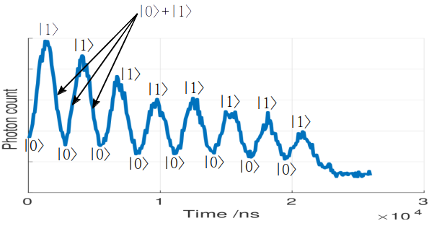
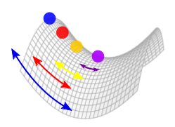
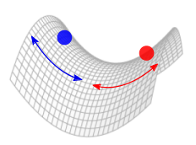


Making trapped ions quantum
Nancy Payne, Naleli Matjelo, Charles Rigby, Hermann Uys
Laser Research Institute, Stellenbosch University
Contact: 19727887@sun.ac.za
Abstract
Challenge #2: getting a qubit
Precise preparation, manipulation and detection of ion qubit states is crucial in quantum computing and quantum simulation. In this work we trap and cool a cloud of Ytterbium 171 ions in a linear Paul trap by using a combination of dynamic and static electric fields to confine the ions. However, regardless of laser cooling, an ion will exhibit additional motion ("excess micromotion") if it does not sit at the centre of the ion trap. This motion can be detected by monitoring the ion's fluorescence and minimised by pushing the ion to the trap centre using additional static electric fields. Once sufficiently cooled, ions are ready to go quantum: the state of the ion can be controlled and detected by using lasers of appropriate power and wavelength, and in this experiment state manipulation was achieved with the application of microwaves to drive Rabi oscillations. The microwave field drives an ion between its two qubit states, which are directly analogous to the values 0 and 1 in classical computing, and these oscillations were observed via ion fluorescence.
A classical bit can be either 0 or 1. A quantum bit (qubit) can be in state
|psi>=|0> or |psi>=|1>, but also something in between, i.e., a superposition:
|psi> = a|0> + b|1>.
Experimental setup
Figure 6: energy levels of Yb 171.
Linear Paul trap: static and dynamic electric fields are used to confine ions.
Lasers are used to cool ions and control their state.
Image of ion trap
Figure 7: the energy levels and laser wavelengths involved in:
a) Doppler cooling,
b) state preparation,
c) state manipulation, and d) state detection.
(the paragraph above can just be the figure caption? Also add arrows to figure, remember it’s a cycle!)
Kristian Mølhave. Construction of and experiments with a linear Paul trap. Institut for Fysik og Astronomi, Århus Universitet, 2000.
Challenge #1: micromotion
(my ions won’t sit still)
What is micromotion and why is it a problem?
An ion feels zero force at the centre of the trap, and a non-zero at every other point. This results in additional ion motion if the ion leaves the trap centre. However, we need our ions as motionless (i.e., as cold) as possible: additional motion affects atomic transition lineshapes, reduces accuracy in high-precision work, and impacts ion confinement time.
How do we observe and remove micromotion?
An ion oscillating in space will have an oscillating scattering efficiency (see Figure 3) due to its motion and the resulting Doppler shift. We can use static electric fields to push the ion closer to the trap centre, reducing the force the ion feels (and thus the ion’s velocity), which in turn reduces the amplitude of the scattering efficiency modulation.
Energy level diagram, indicating scattering transition and detuning
Results: Rabi oscillations
(we have a qubit!)
Repeat the above steps for varying microwave pulse durations and count the number of photons an ion scatters during state detection. When averaged over many measurements, this photon count is an indication of the probability of the ion to be found in state |1>.
Few words on phase flip.
|1>
|0> +|1>
Figure 8: the photon count at different microwave pulse durations, indicating an oscillation of the ion wavefunction between qubit states |0> and |1>. Each data point represents an average of X measurements. The gradual decrease in amplitude is due to ions escaping the trap.
Figure 3: due to the Doppler effect, an ion’s scattering efficiency depends on its velocity.
x
Results of micromotion compensation
Observing and reducing micromotion
Finding the trap centre
/probability to find ion in |1>
x
x
x
x
|0>
Next steps
Figure 4: ions that are on average closer to the centre of the trap (as shown below) have reduced motion and thus the magnitude of the scattering rate modulation.
Figure 5 (below): the motion of the blue and red particles above will be out of phase. Equivalently, pushing an ion across the centre of the trap results in a 180 degree phase difference in the motion, and thus also the scattering modulation (above)..
The successful observation of Rabi oscillations indicates that we can successfully prepare, manipulate and detect our qubit’s state. The next steps are:
* entanglement -- entangling the ion’s vibrational state to its internal (spin) state
* weak measurements (i.e., measurements that minimally disturb the state of a quantum system)
* measuring dynamic correlation functions (relating the value of an observable at one time, to the value of another observable at some later time).
Purple: micromotion has
been minimised by pushing
ion to centre of trap
This work is based upon research supported by the
South African Research Chair Initiative
of the Department of Science and Technology
and the National Research Foundation
<Insert Header into faded banner>
Notes:
<number>

